Slide 1
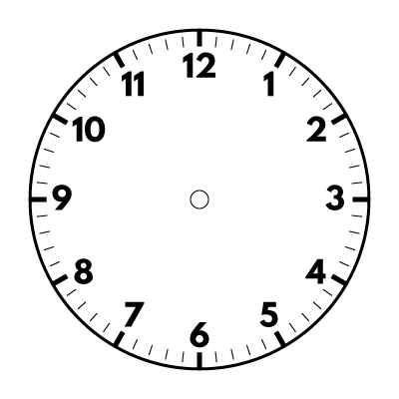
Year 5 | Week 3 | Day 1

Slide 2
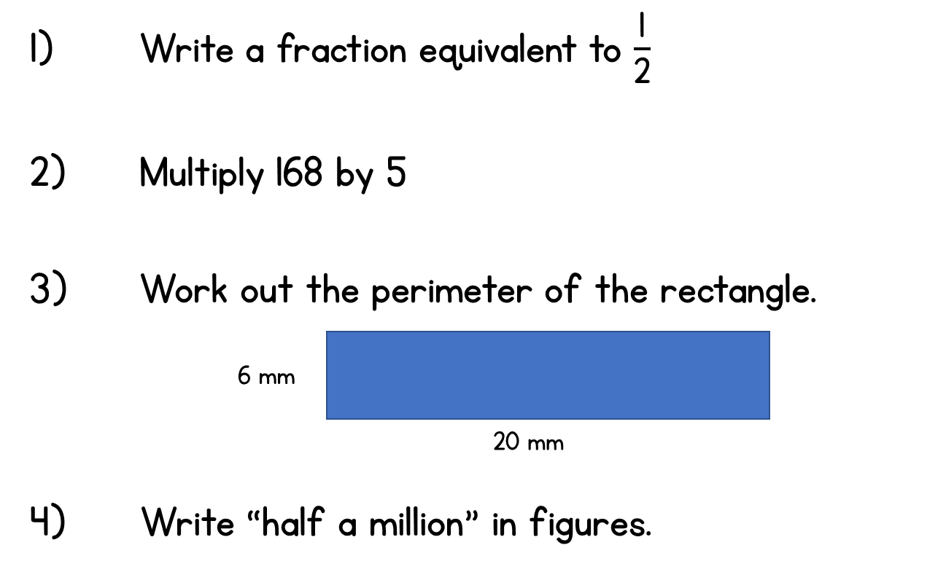
Year 5 | Week 3 | Day 2

Slide 3
Year 5 | Week 3 | Day 3

Slide 4
Year 5 | Week 3 | Day 4

Slide 5
Year 5 | Week 3 | Day 5

Slide 6
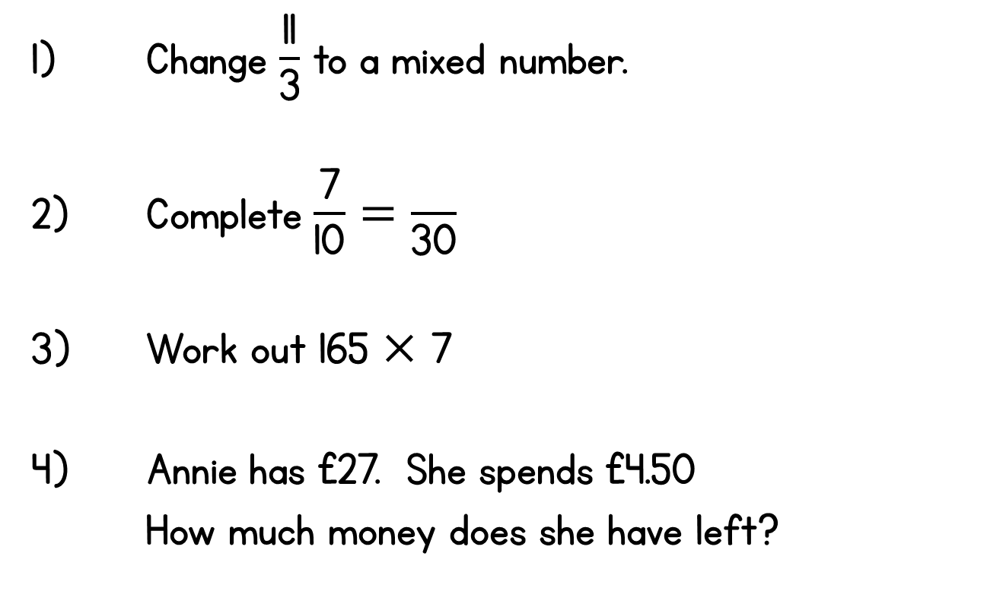
Year 5 | Week 4 | Day 1

Slide 7
Year 5 | Week 4 | Day 2

Slide 8
Year 5 | Week 4 | Day 3

Slide 9
Year 5 | Week 4 | Day 4

Slide 10
Year 5 | Week 4 | Day 5

Slide 11
Year 5 | Week 5 | Day 1

Slide 12
Year 5 | Week 5 | Day 2

Slide 13
Year 5 | Week 5 | Day 3

Slide 14
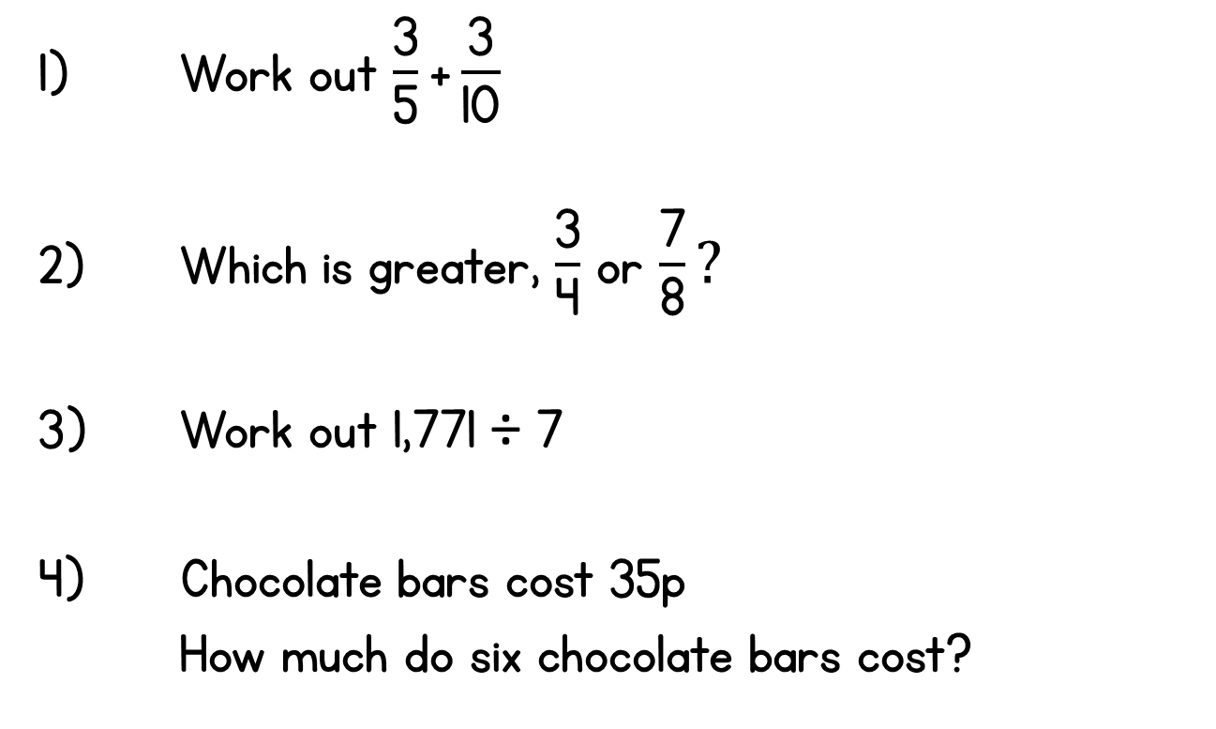
Year 5 | Week 5 | Day 4

Slide 15
Year 5 | Week 5 | Day 5

Slide 16
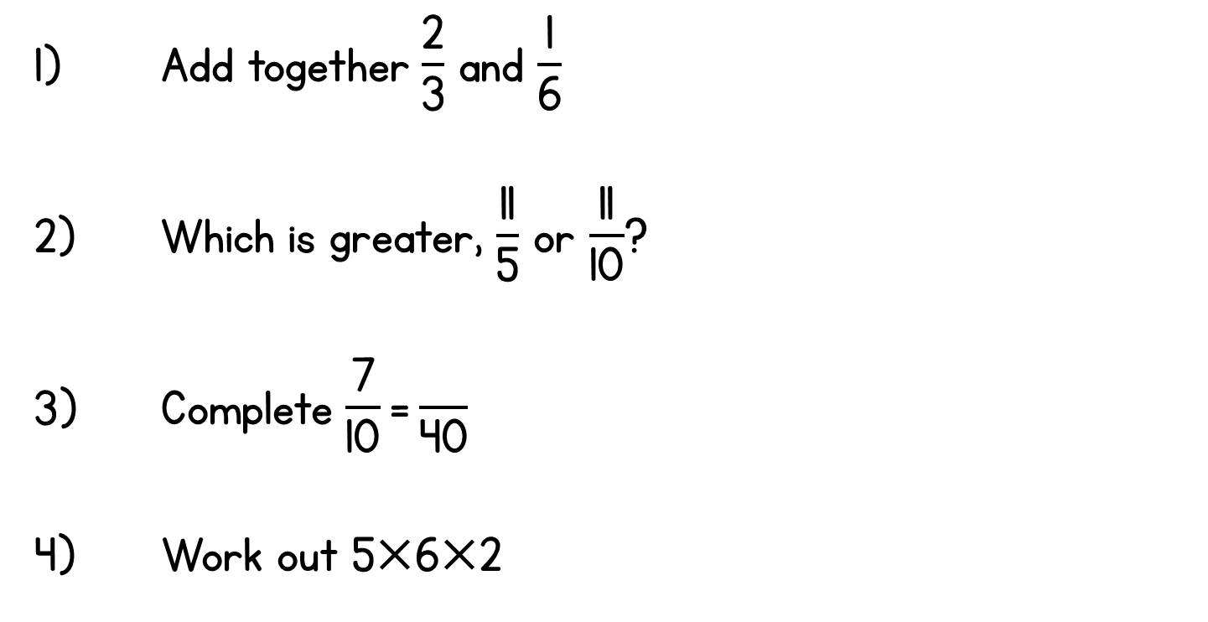
Year 5 | Week 6 | Day 1

Slide 17
Year 5 | Week 6 | Day 2

Slide 18
Year 5 | Week 6 | Day 3

Slide 19
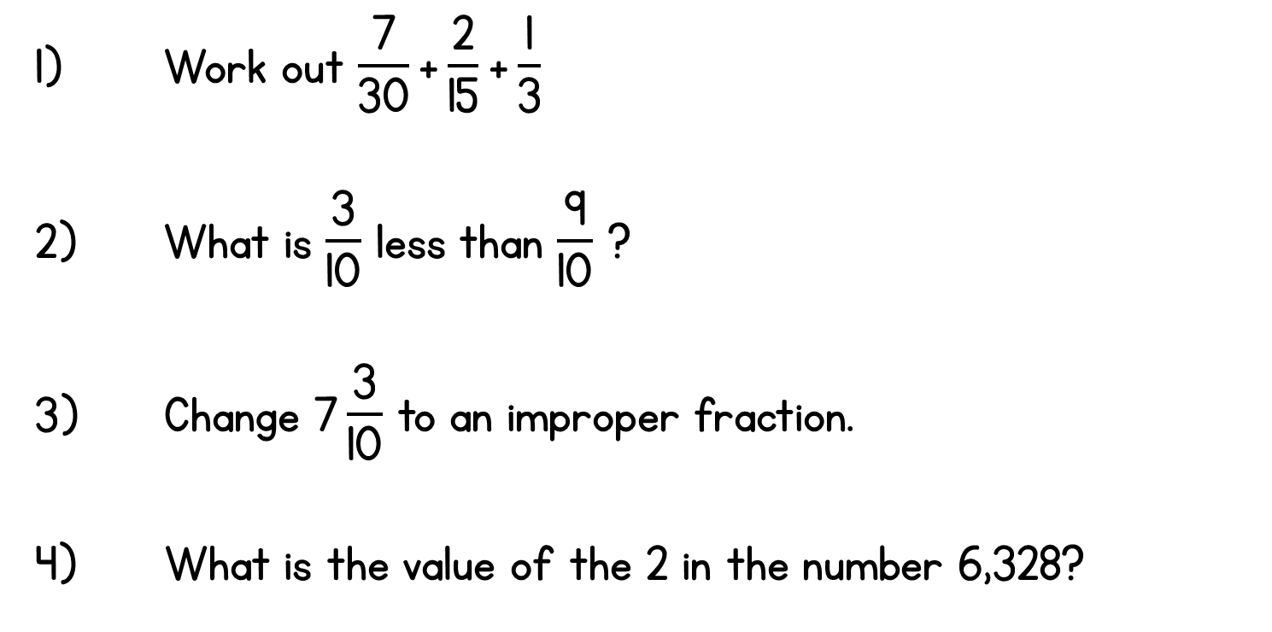
Year 5 | Week 6 | Day 4

Slide 20
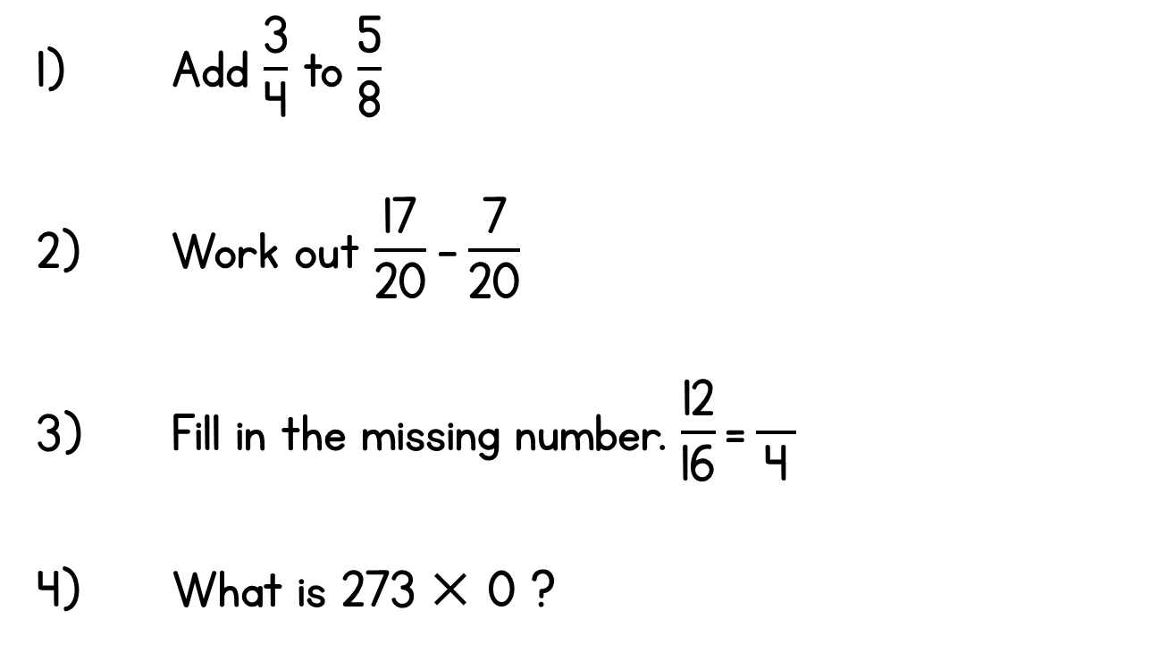
Year 5 | Week 6 | Day 5

Slide 21
Year 5 | Week 7 | Day 1

Slide 22
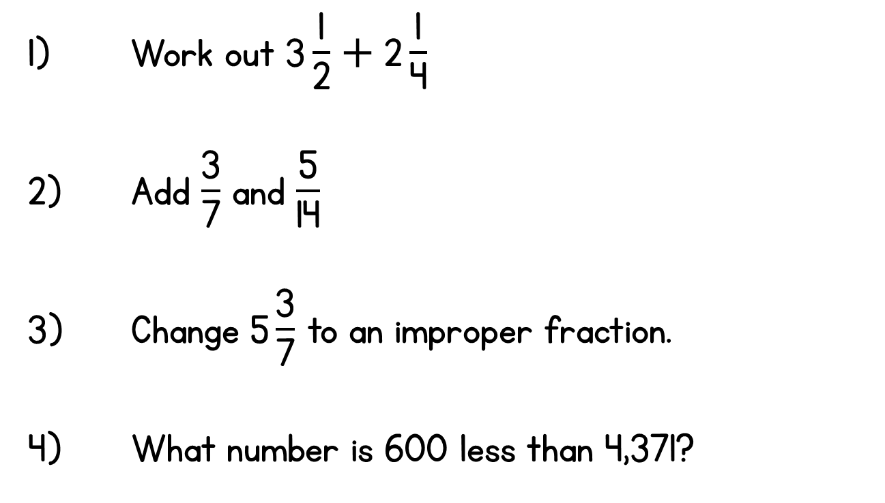
Year 5 | Week 7 | Day 2

Slide 23
Year 5 | Week 7 | Day 3

Slide 24
Year 5 | Week 7 | Day 4

Slide 25
Year 5 | Week 7 | Day 5

Slide 26
Year 5 | Week 8 | Day 1

Slide 27
Year 5 | Week 8 | Day 2

Slide 28
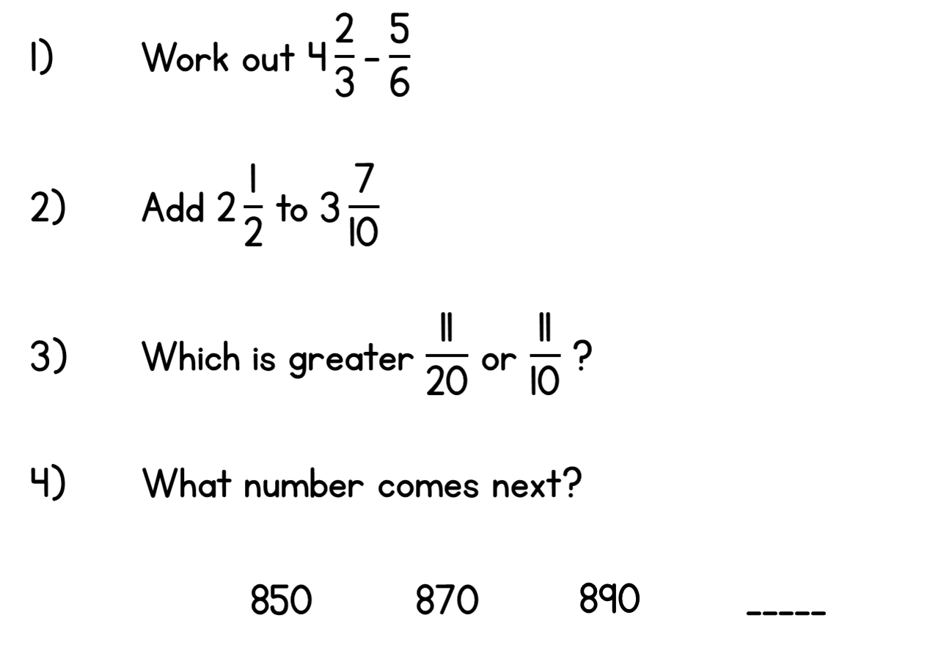
Year 5 | Week 8 | Day 3

Slide 29
Year 5 | Week 8 | Day 4

Slide 30
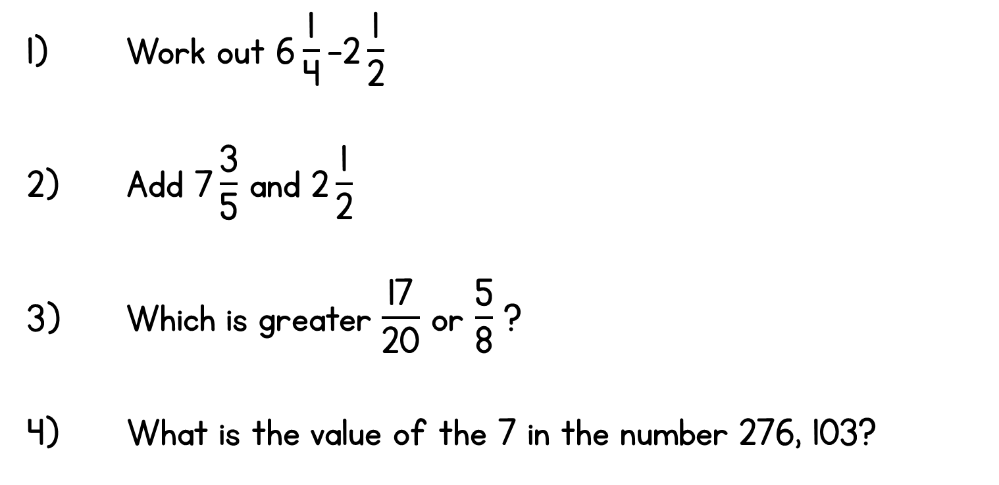
Year 5 | Week 8 | Day 5

Slide 31
Year 5 | Week 9 | Day 1

Slide 32
Year 5 | Week 9 | Day 2

Slide 33
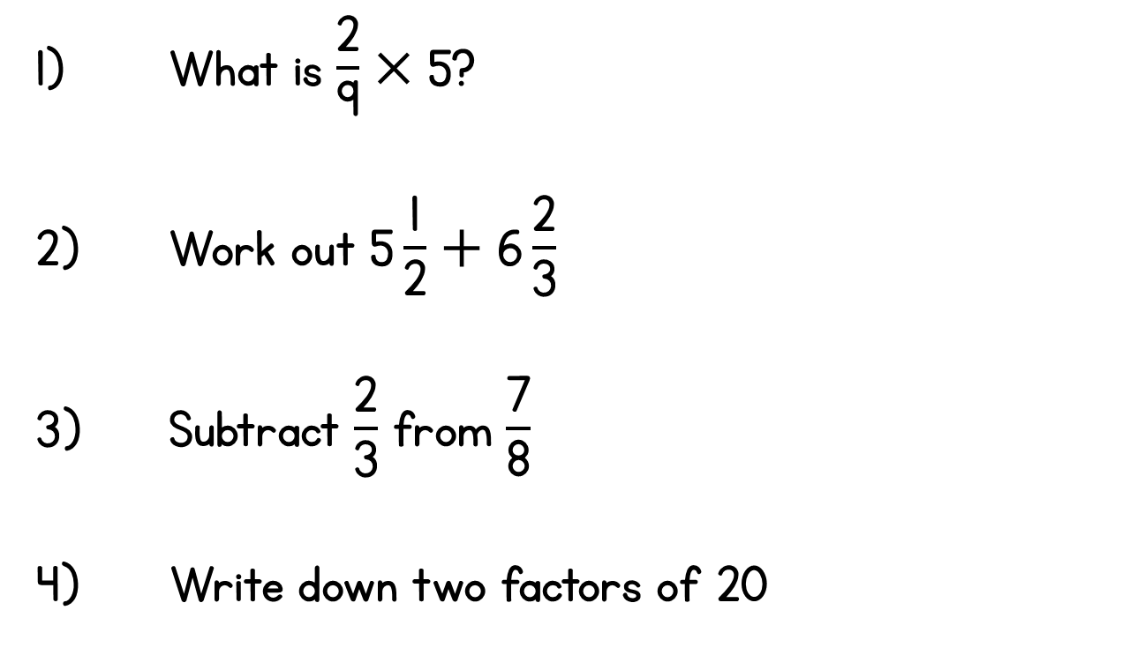
Year 5 | Week 9 | Day 3

Slide 34
Year 5 | Week 9 | Day 4

Slide 35
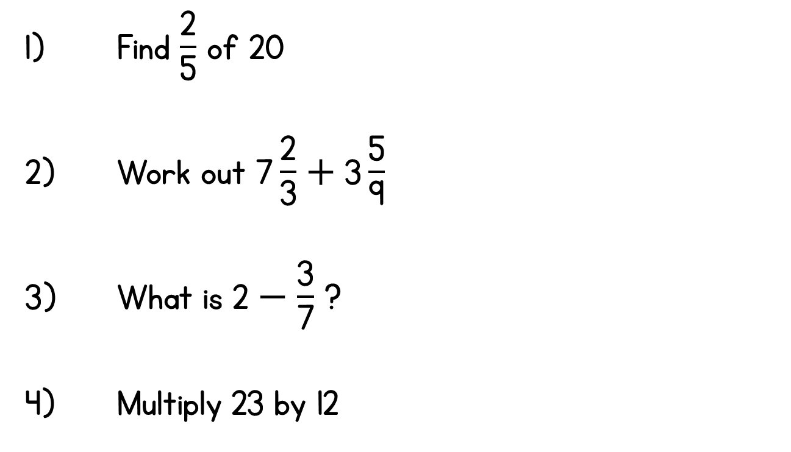
Year 5 | Week 9 | Day 5

