Slide 1
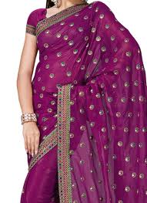
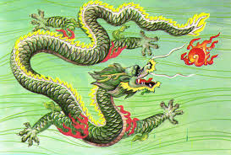
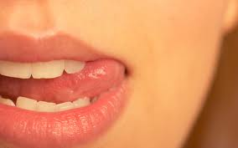
The Magic Box
I will put in the box
The swish of a silk sari on a summer night,
Fire from the nostrils of a Chinese dragon,
The tip of a tongue touching a tooth.

Slide 2
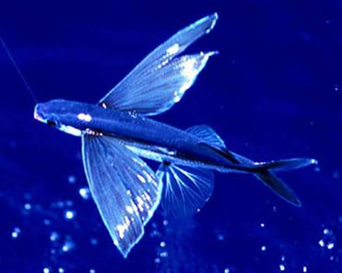
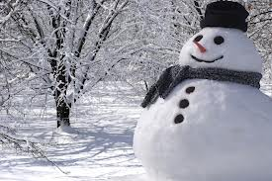
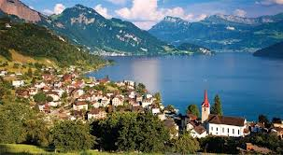
I will put into the box
A snowman with a rumbling belly,
A sip of the bluest water from Lake Lucerene,
A leaping spark from an electric fish.

Slide 3
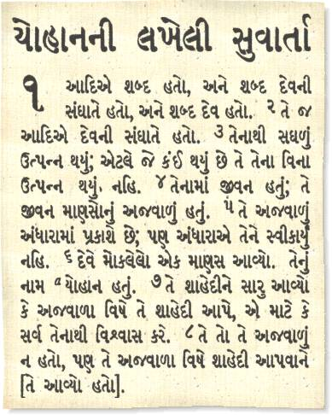
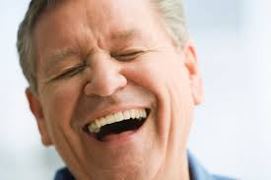
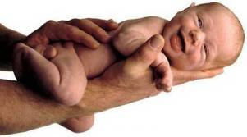
I will put into the box
Three violet wishes spoken in Gujarati,
The last joke of an ancient uncle,
And the first smile of a baby.

Slide 4
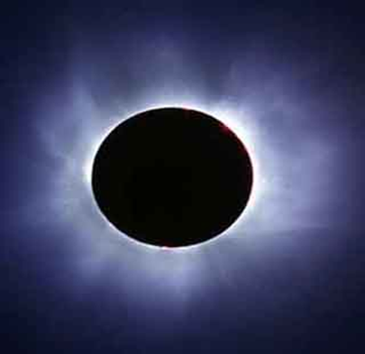
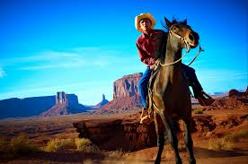
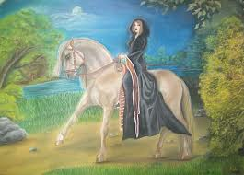
I will put into the box
A fifth season and a black sun,
A cowboy on a broomstick,
And a witch on a white horse.

Slide 5
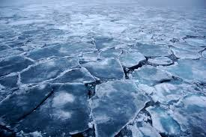
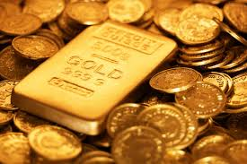
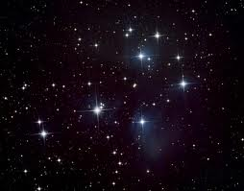
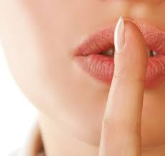
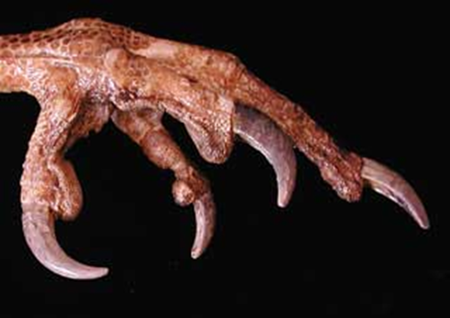
My box is fashioned from ice and gold and steel,
With stars on the lid and secrets in the corners.
Its hinges are the toe joints of dinosaurs.

Slide 6
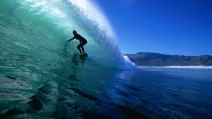
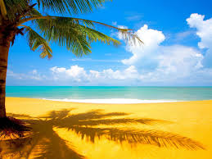
I shall surf in my box
On the great high-rolling breakers of the wild Atlantic,
Then wash ashore on a yellow beach
The colour of the sun.

Slide 7
I will put in the box
The swish of a silk sari on a summer night,
Fire from the nostrils of a Chinese dragon,
The tip of a tongue touching a tooth.
I will put into the box
A snowman with a rumbling belly,
A sip of the bluest water from Lake Lucerene,
A leaping spark from an electric fish.
I will put into the box
Three violet wishes spoken in Gujarati,
The last joke of an ancient uncle,
And the first smile of a baby.
I will put into the box
A fifth season and a black sun,
A cowboy on a broomstick,
And a witch on a white horse.
My box is fashioned from ice and gold and steel,
With stars on the lid and secrets in the corners.
Its hinges are the toe joints of dinosaurs
I shall surf in my box
On the great high-rolling breakers of the wild Atlantic,
Then wash ashore on a yellow beach
The colour of the sun.
‘The Magic Box’ – Kit Wright

Slide 8
Now it’s your turn
Close your eyes and imagine your own magic box.
What is it made out of?
What thoughts/feelings/emotions/objects will you put in it?
Think carefully about things that are important to you…
Sounds, feelings, places, tastes, thoughts, beautiful things, smells

