Slide 1

Phonics- September 2025
Welcome Parents and Carers of Year 1!
Notes:
Thank you for coming and supporting us in our efforts in what needs to be a joint aim of helping our children become fluent readers, to enable them to learn and to get enjoyment from the amazing books available to them.
Introduce staff present and roles.

Slide 2

WHAT DOES ‘PHONICS’ MEAN?
‘Phonics’ is a method of teaching people to read by training them to associate letters with their sounds.
What are we doing?
What do you need to be doing?
Notes:
Could be a single letter or letters combined which make a ‘unit’ of sound.
US: Our job to train the children to understand this complicated code.
We have daily Phonics lessons where the children are grouped based on their needs and we also have afternoon interventions.
Small group guided reading sessions – firstly practising decoding in real context, moving increasingly on to comprehension/understanding of the text.
YOU: Not a strict regime of homework but expectation and need should all be focused on reading at this age. Showing interest and support in their reading through listening to them, as they practise reading regularly. (Help us by noting in reading record) AND sharing books/stories with them for enjoyment.

Slide 3
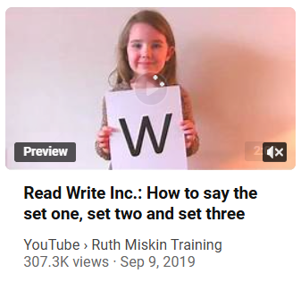
Sounds
All words are made up of sounds
In English there are 44.
These sounds should be pure – no ‘uh’
Bing Videos
Notes:
Explain we use pure sounds (‘m’ not’ muh’, ’t’ not ‘tuh’, etc.) so that your child will be able to blend the sounds into words more easily. Say that in school we use a puppet called Fred who can do this beautifully! We call talking like this Fred Talk. Hold up a Fred!
C-a-t m-a-t

Slide 4

Graphemes
A grapheme is a sound written down
English has more than 150 graphemes
A complex code!
Notes:
In the English language we have more than 150 ways to represent the 44 sounds using our 26 alphabet letters, so groups of letetrs are used as well as single letters – these are called graphemes.
We will teach the 100 most commonly used graphemes for the 44 sounds (phonemes).
We will teach them systematically and very thoroughly.

Slide 5
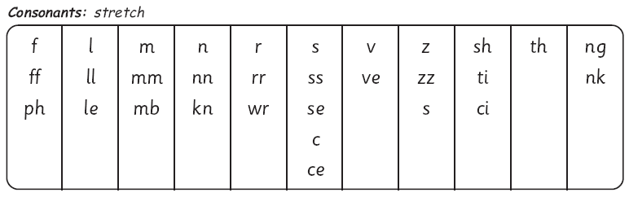
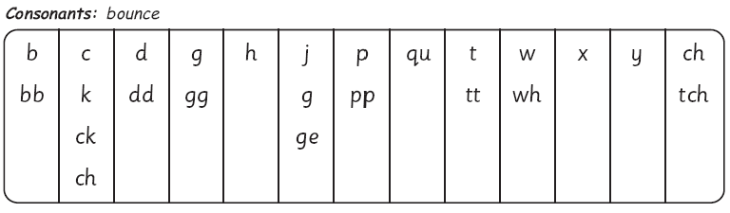
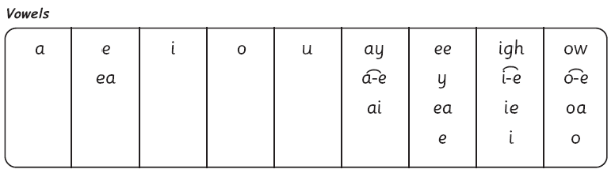
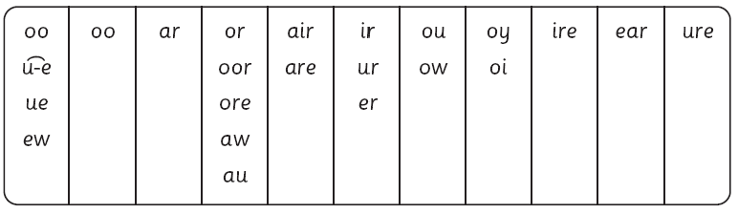
The complex English alphabetic code
Notes:
This chart shows the most usual graphemes for the 44 sounds
Explain that each box is a sound box showing different ways to read and write the sound. Demo with the or sound box with examples of words such as or, morning, door, more, dawn, author.
Explain stretch and bounce.

Slide 6

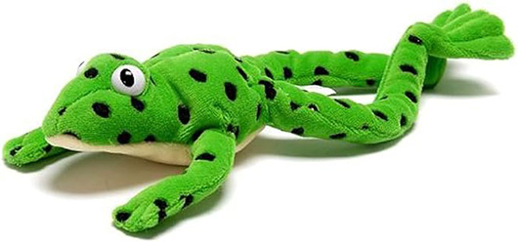
Fred...
Fred helps children learn to read
Fred can only talk in sounds...
(Fred can only say c_a_t, he can’t say cat)
We call this Fred Talk
Notes:
Hold up Fred! Say you too can have a Fred at home – use one like this or any stuffed toy.
Fred says….
We say…

Slide 7
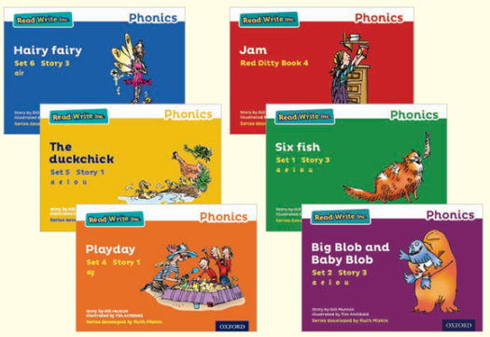
Fred...
If children understand Fred
they can blend orally
Blending is needed for reading
Notes:
Use My Turn Your Turn with the parents to have a go at some Fred Talk – you Fred Talk a CVC word d_o_g, they Fred Talk it back & ask them to tell you what word Fred is trying to say. Do a few words – sh_o_p, d_ay, s_p_l_a_sh etc. This is oral blending.
Say that once your child knows the graphemes for each sound, they can use Fred Talk for reading any word – write one of the words on a board and Fred Talk then say whole word – point to each grapheme as you Fred Talk it.

Slide 8
Fred...
Fred helps children learn to spell too!
Children convert words into sounds
They press the sounds on to their fingers...
We call this Fred Fingers
Notes:
Show how to use fingers to spell some of the words you have just blended. Use My Turn Your Turn with the parents – say “show me three fingers – the word is dog.” (or shop or wish or any 3 sound word) “Now pinch the sounds on your fingers!”
This is the reversibility principle of decoding for reading and encoding for writing.

Slide 9

At home…
Have fun with Fred Talk at home!
“What a tidy r-oo-m!”
“Where’s your c-oa-t?”
“Time for b-e-d!”
back, head, tum, leg, hand, foot, knee
coat, hat, scarf, zip, sock, glove
run, walk, skip, hop, fast, slow, stop, shop
red, blue, green, black,
knife, fork, spoon, plate, bowl, pan
bread, cheese, meat, soup, jam, cake
Notes:
Give a couple of examples e.g. Where is your c_oa_t? Time for b_e_d! Make sure your child can tell you what the word is.
Use only single syllable words (no Fred Talking multi-syllabic words) and only the last word in a sentence or it gets very silly! E.g. P_u_t o_n y_our b_l_ue c_oa_t (you’ll never get out!).

Slide 10
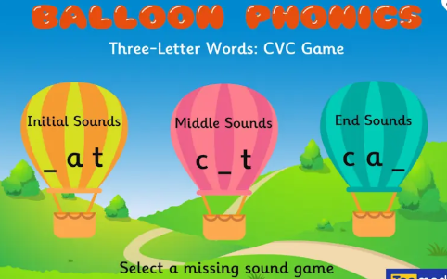
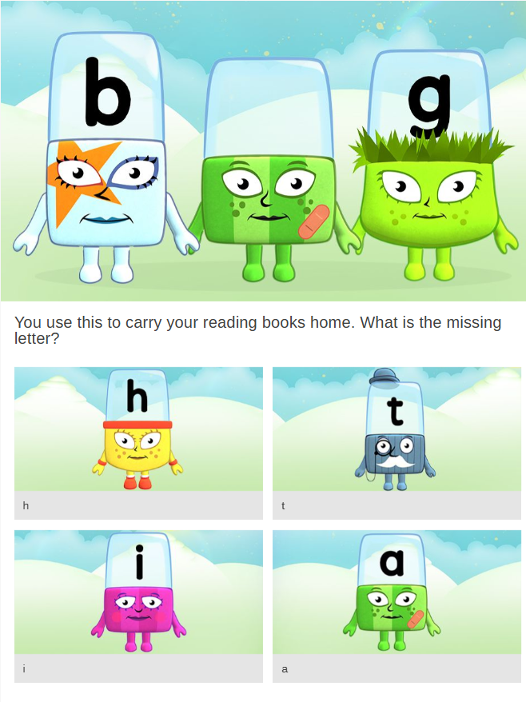
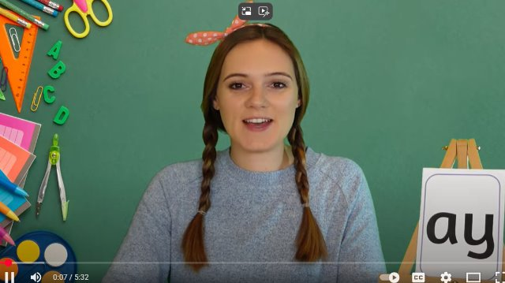
Other ways to have fun with Phonics!
Bing Videos
Buried Treasure

