Slide 1

Accelerator Reader
Year 3

Slide 2
Contents
Star Test, ZPD level and reading age
Reading books and quizzes
Moving up levels
How to help at home
Reading Comprehension Year 3
Any questions

Slide 3
Star Tests
Fluency and decoding words is still important.
Move to comprehension and understanding the text (what is this story/non-fiction book about). This is throughout KS2.
Comprehension skills are taught continuously at school, but these skills should be evident in children’s reading.
Children complete half-termly star tests to check progress and correct reading level.
Star tests are completed independently in test style conditions to gain accurate results.
A practise is at the start of the star test; this needs to be completed accurately to continue with test.

Slide 4
ZPD Level and Reading Age
Each star test checks comprehension. Children answer a range of questions based on texts of varying length and given multiple choice options.
At end of test, teachers see a ZPD level. This tells teachers what reading range children should be selecting books from. E.g. if a child has a ZPD of 0.9-1.9, the children can choose any books within this range.
Star test results also provide reading age of child based on comprehension not fluency.

Slide 5
Reading books and quizzes
When a child has read their book, at home or in school with an adult, they will have the opportunity to take a quiz before changing their book.
Quiz should be completed independently.
Quiz asks questions about the book and assesses children’s understanding of book.
Children can use the book to answer questions.

Slide 6
How often to take quizzes.
The number of quizzes children do depends on the length of the book.
We would like to see the majority of children quiz at least twice a week.
Children are more than welcome to quiz daily.
Children reading longer books e.g. chapter books should be ready to quiz after 4 days. This obviously depends on length of book, but longer between quizzes means retaining understanding can be tricky.
80% and above shows good understanding of book.

Slide 7
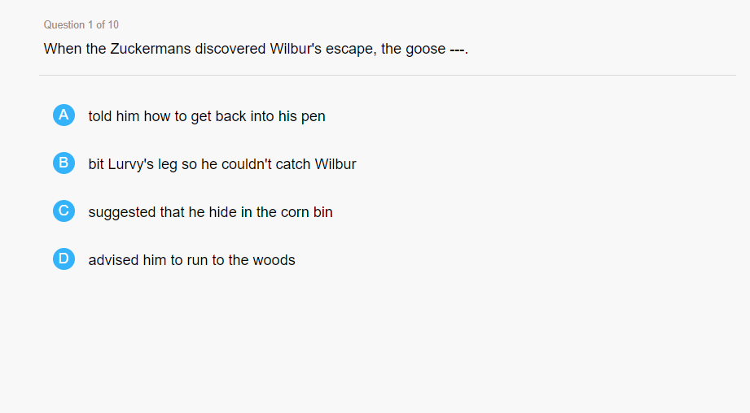
This is what questions from the book that your child reads would look like. Depending on the level of book there are a minimum of 3 questions and a maximum of 10 questions.
The children have multiple choice options and should use the book to help them find the answers.

Slide 8
How to help at home
When listening to children read at home, ask plenty of questions.
E.g. What is happening on this page/chapter?
What was the story about?
What happened at the start?
What happened at the end?
How was this character feeling?
What is _______?
We will provide some question starters to use at home.
Children should be reading atleast 3x a week – please sign your children’s records as we check these weekly.

Slide 9
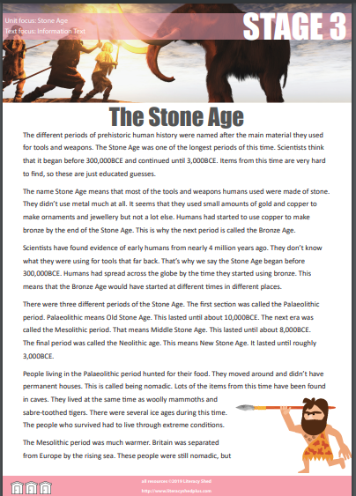
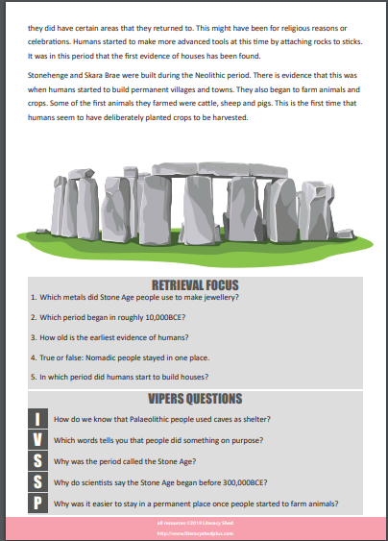
Comprehensions Year 3
We use Reading VIPERS
V – Vocabulary
I – Inference
P – Prediction
E – Explanation
R – Retrieval
S – Sequence or Summarise
In Year 3, we complete a range of reading comprehensions, three times a week. We use VIPERS to
help check children’s understanding. We also read a whole class book twice a week.

Slide 10
Any questions
Please feel free to ask any questions.

